Slide 1
FY27 HERITAGE BUDGET PRESENTATION
5.31.2026

Slide 2
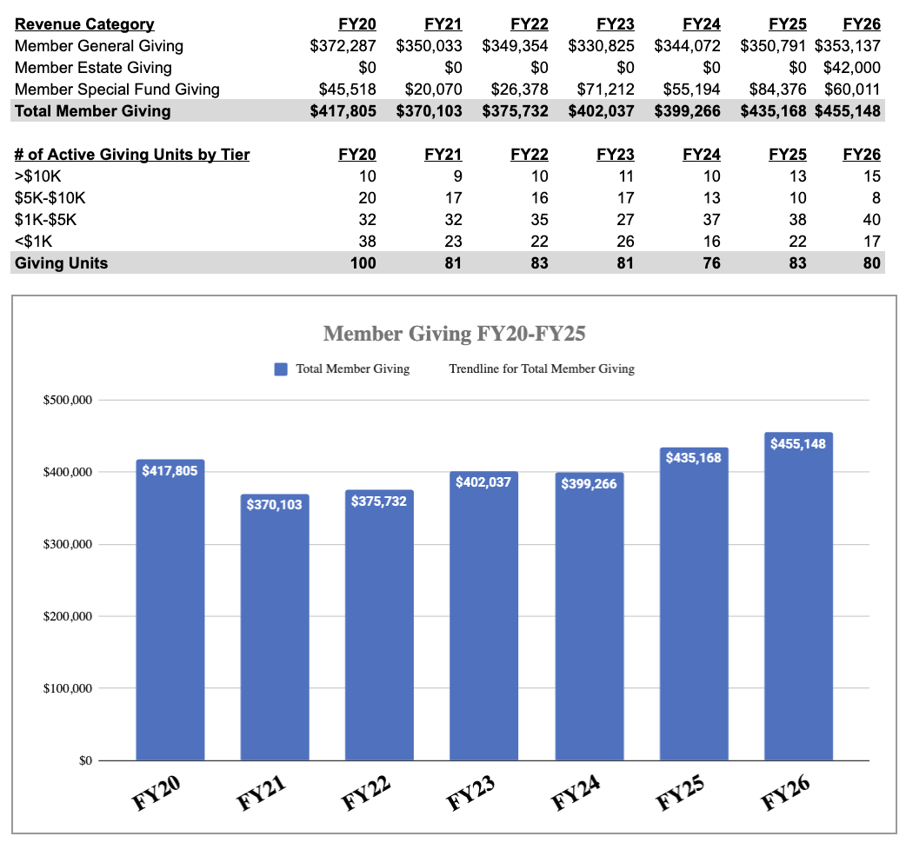
REVENUE
PUNCHLINE:
General fund giving was roughly flat in FY26. School Relief Fund and Debt Reduction Fund Giving stayed strong, and a large estate gift led to an increase in overall giving in FY26.

Slide 3
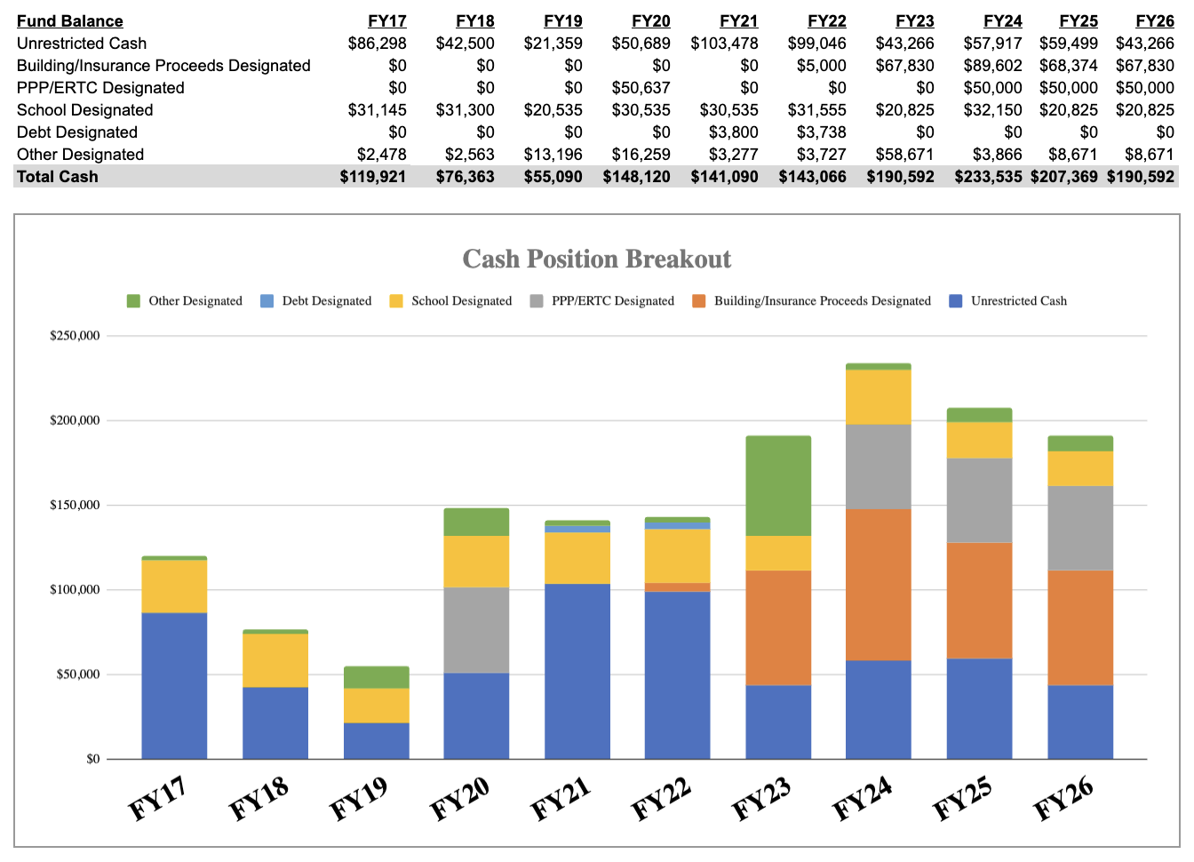
CASH
PUNCHLINE:
Total cash position declined in FY26, but still remains strong.

Slide 4
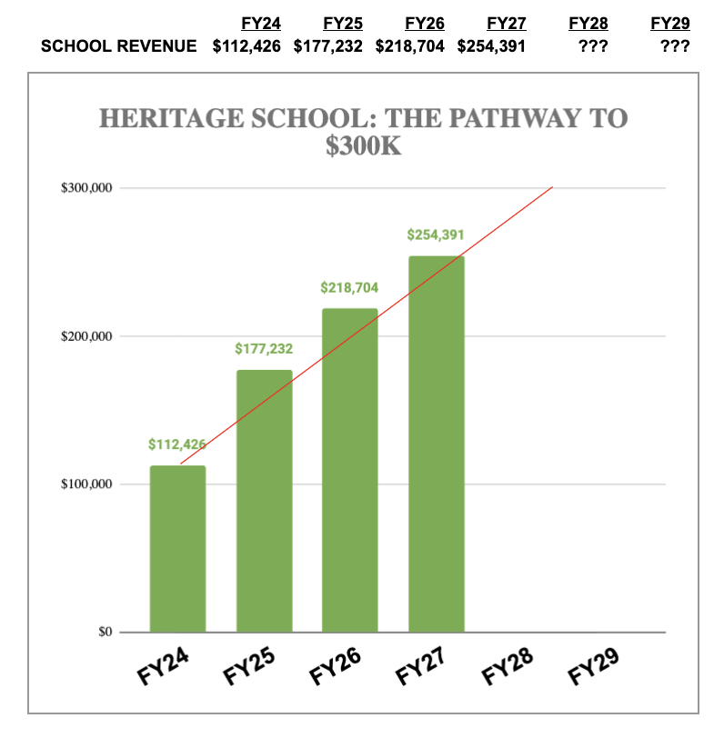
SCHOOL
PUNCHLINE:
School revenue is continuing to improve due to enrollment increases, summer program offerings, and tuition increases.
School operating deficits continue to decline. Slower than originally hoped, but still showing continued improvement.

Slide 5
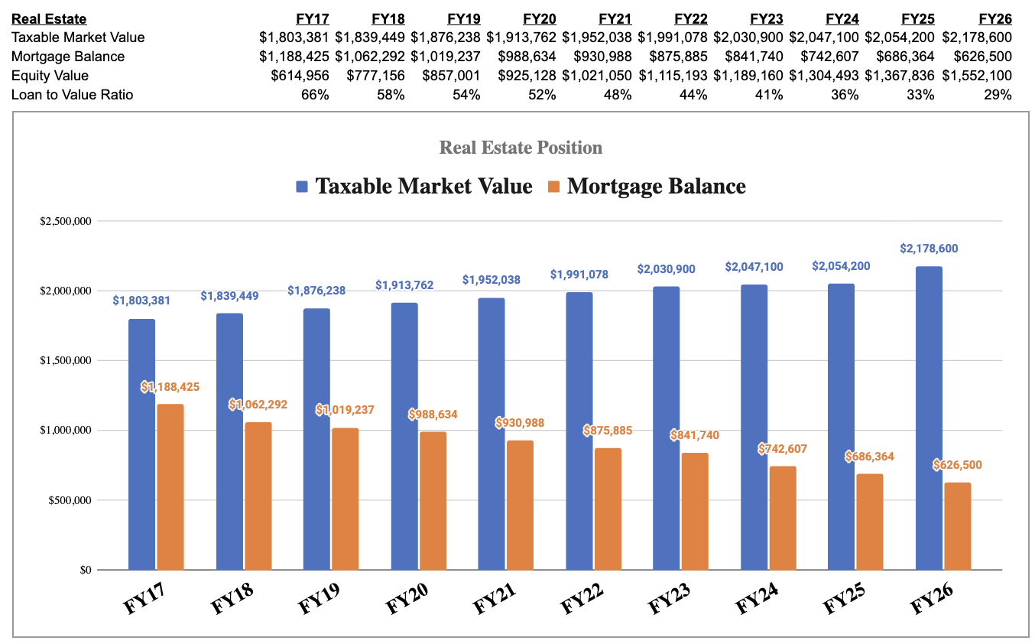
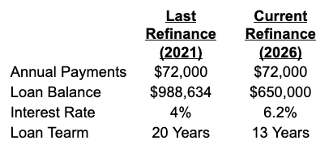
DEBT
PUNCHLINE:
The church’s property value in excess of debt has now exceeded $1.55M, which is up over $0.4M over the last 5 years.
Refinancing efforts in 2026 held the churches payment at the same level and reduced amortization period from 20 to 13 years.

Slide 6
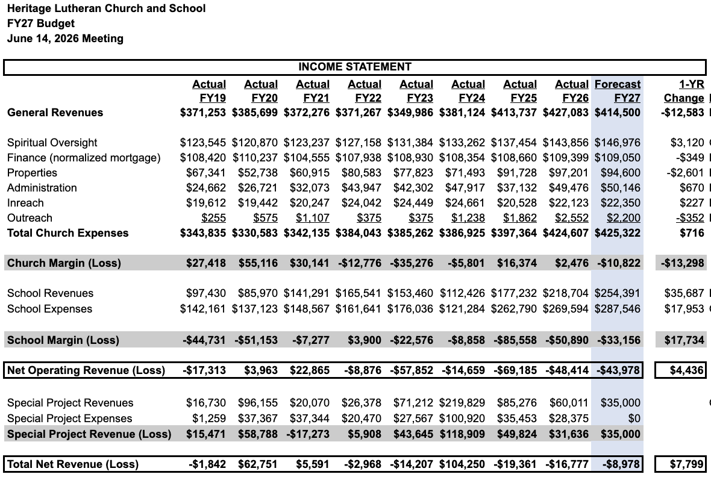
FINANCIAL SUMMARY
SUMMARY POINTS:
School resiliency has continued to improve. The K-2 expansion plan is still working.
Cost inflation continues to put financial pressure on the church operating budget.
There will be some substantial facilities projects coming up in the future that will need further consideration beyond what is included in this budget (parking lot resurfacing, roof, etc).
Cash reserves and accessible equity in the church property will be available to support these efforts.

